Slide 1
All Staff Briefing
February 2026

Slide 2
Welcome and Objectives
Key objectives for this session:
To share key messages with colleagues
Council Plan / Strategic Planning Update
To summarise our budget position for 2026/27
To update on the process for Local Government Reorganisation (LGR)
Consider any feedback or questions

Slide 3
Update on Council Plan
Lorna Ford, Chief Executive

Slide 4
Strategic planning
February: Full Council agree final budget and revised Council Plan
March: Agreement of Key Performance Indicators for 2026/27
June/July: Budget setting cycle for 2027/28 begins
June: Service plans and appraisal data collated
March: Chief Executive and Heads of Service appraisals
April – May: Manager/officer appraisals
March – April: Service planning takes place

Slide 5
Council Plan 2025-2029
Our Council Plan is the top-level strategic document for the council and helps to connect every team’s work to our shared objectives.
Since the plan was adopted in December 2024, several major changes (including LGR) have impacted its delivery. In response, a refreshed version has been developed and is due to be reported to Full Council next week.
While some of the council’s actions have been amended, our strategic outcomes remain unchanged:
A Thriving Local Economy
We will continue to make the most of the significant investment in our district, creating the right conditions to grow our economy, boost skills, and deliver well paid jobs. The district will be recognised as a world class visitor destination.
Live Well Locally
We will be recognised as an inclusive and fair district, planning the delivery of affordable homes and working with partners to support the wellbeing of our residents. We will enhance the quality of our residents’ lives by enabling the provision of good quality leisure facilities and access to open spaces.
Green to the Core
By taking bold action to tackle climate change and protect the environment in all that we do, we will make the district climate resilient and reduce council emissions to net zero by 2030.

Slide 6
Budget 2026/27
Charlotte Spendley, Director of Resources

Slide 7
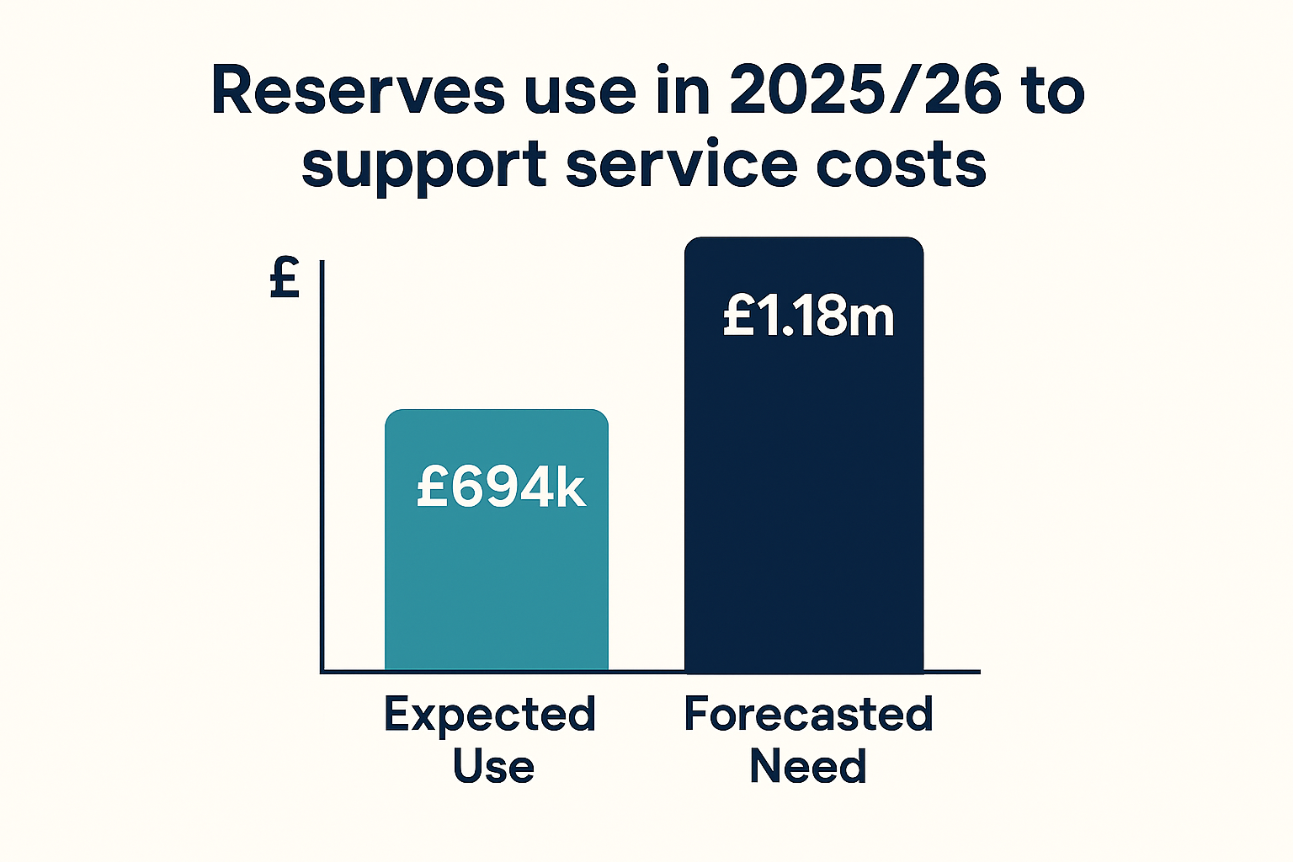
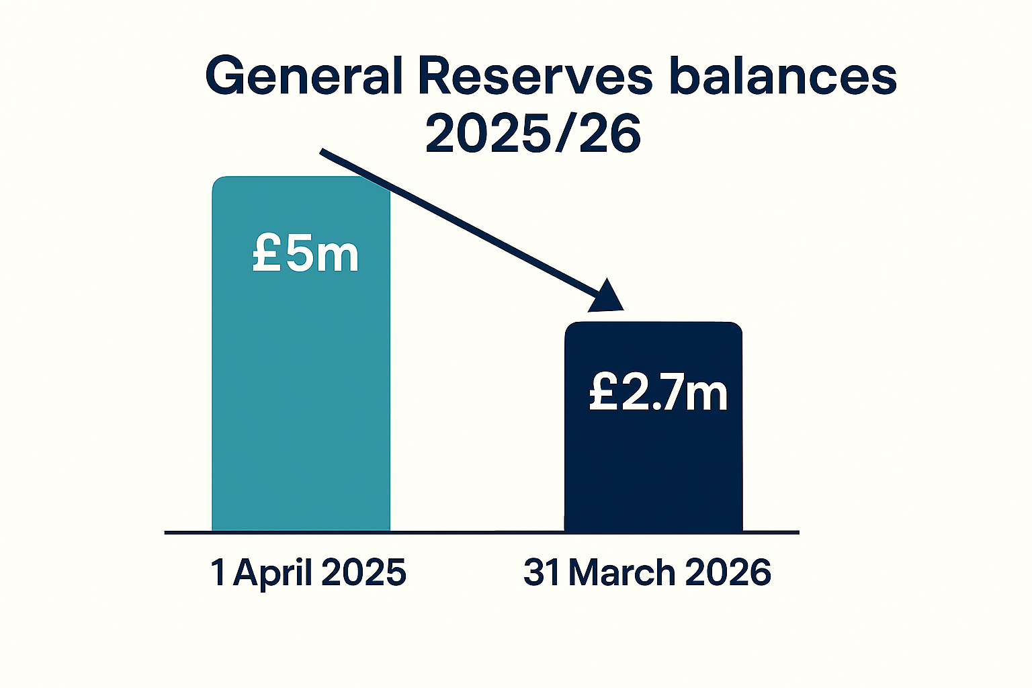
Current Financial Year 2025/26
Notes:
Introduction of SCP, useful to set out the financial landscape we are working within, and why we are having to be really robust (and ask you all to be really robust) in our spending decisions because it remains challenging picture
Budget set for the current financial year (runs to 31 March) assuming use £694k of reserves, as we didn’t anticipate having sufficient income to cover our costs, we are now forecast to use £1.18m, working an update to this position for March reports to Members
General reserve, which is our reserve we can use for any purpose, forecast to reduce from £5m to £2.7m, in addition to the draw from it to support our service costs this year, we had an investment which lost value and we had to abort some capital schemes which weren’t deliverable.
To put this into context the council spends over £50m p.a. on services, and has a capital programme of £124m to be delivered between 2025/29-2029/30

Slide 8
Budget Process 2026/27
June
HoS identify potential growth and savings (Budget Challenge exercise)
July/ August
Member panels consider Budget Challenge proposals
October
Overview & Scrutiny Committee consider Budget Challenge proposals
November
Cabinet agreement to draft proposals for public consultation
November/ December
Detailed budget review by Budget Managers and Finance
December/ January
Public consultation on budget proposals
January
Draft Budget considered by Overview & Scrutiny Committee (& on to Cabinet 2 February)
Notes:
Lengthy process, significant member input and consultation. This year much lower levels of public engagement on the proposals, 83 comparative to 1300 the prior year.

Slide 9
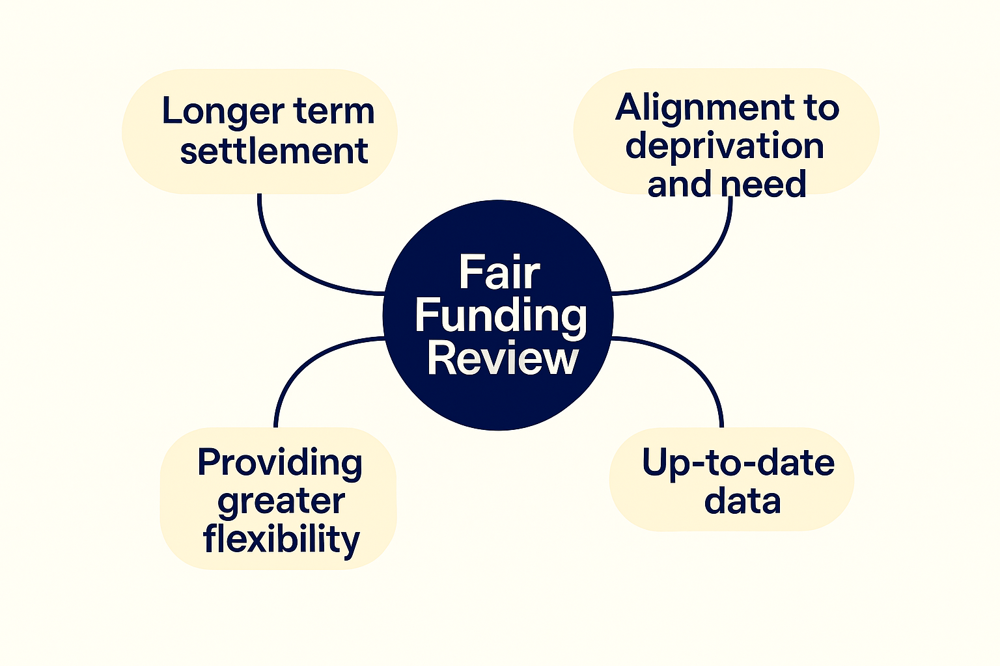
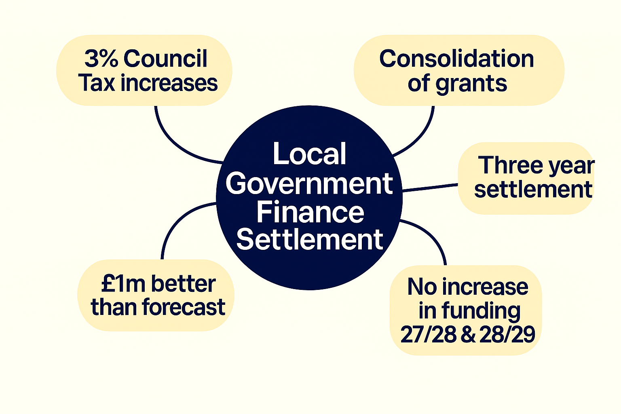
Government Funding
Notes:
Much awaited FFR was published in June
Explored the Governments proposed approach to LG funding reform from 26/27 onwards
They committed to a fairer and simpler system
Funding to be aligned to depreviation & need, based on up to date data, with longer term settlements spanning multi-years & additional flexibility
Included a Business Rates reset – reallocation of funding across the country aligned to need, resources and growth with transitional support
LG FS
Published just ahead of Christmas
In line with principles of FFR
Updated formula and underlying data
Focused on deprivation
3 year settlement, positive news as aids planning
Fundamental shift in grant funding
3% Council tax to remain limit of increases without a referendum
We did better than anticipated in 26/27, but our settlement for the next two years is less favourable with extremely limited uplifts.

Slide 10
Financial pressures continue
🏠 Demand & Service Pressures
  Homelessness & Temporary Accommodation
  New Food Waste Service
  Aging estate requiring maintenance & investment
📉 Income Volatility
  Planning income
  Parking income
💼 Internal Cost Pressures
  Staff pay
  Contractual inflation
  Borrowing costs
🌐 External / Environmental Challenges
  Restriction of council tax increases
  Cyber prevention
Notes:
We are setting this budget in a time that many pressures remain
Demand led services such as homelessness and resulting TA pressures continue to increase
From 1 April Council is required to roll out new food waste service, costs circa £1m in service costs
We are reliant on our fees & charges which account for around 20% of our overall income annually, but they are subject to external factors affecting the levels achieved annually, to good examples of this are planning income which is heavily reliant on the buoyancy of the housing market and broader economic climate of the country. And parking income which is affected by seasonal weather.
Naturally our cost base is rising due to contractual and staff pay inflation, emerging growth areas like cyber attack prevention measures. Additionally the 26/27 budget also sees the council holding less cash balances and more debt, affecting our financing costs.
We remain restricted in the levels of council tax we can raise from residents.
In light of LGR the capital programme has been reviewed and will remain focused on the schemes we already have underway and are committed to delivering, providing the best legacy for rother and our residents.

Slide 11

Balanced Budget – 2026/27 Headlines
✔️ Balanced budget achieved without using reserves
💷 Council retains <9% of collected Council Tax
⚖️ Long-term challenges remain
🤝 Collective responsibility across all services
🌟 Thank you for everyone’s continued efforts
Notes:
But now the good news!
Despite that challenging environment, for the coming financial year I am very pleased to say we have balanced the budget without the use of reserves for the first time in a couple of years.
This is no mean feat!.
We have also modelled the position for the following two financial years (27/28 and 28/29) and as I mentioned before that is more difficult to balance without the use of reserves, so our continued diligence is really important, as we want to see out RDC’s term and remain financially sound, ideally with some reserves (even a modest sum) available to transfer to the new authority.
The balanced budget, is the culmination not just of a better than anticipated settlement from the government, but also the hugely detailed and significant work undertaken by all departments over the last three years particularly to reduce costs and maximise income. Over £3m has been saved over this time.
I would like to thank all involved in both the budget challenge, detailed budget, and on the ground delivery of these savings.
You can all make a difference, in challenging yourself whenever we spend.
Thank you to

Slide 12
Update on Local Government Reorganisation (LGR)
Lorna Ford, Chief Executive

Slide 13
LGR – how we got here...
Dec 2024: Government decides all two-tier areas will become unitary - replacing current county councils and district and borough councils.
Proposals for new unitary councils (with populations of at least 500,000) to:
  achieve efficiencies
  improve capacity
  withstand financial shocks
  enable strong community connections
  enable wider public service reform.
Feb 2025: East Sussex announced in fast track (Devolution Priority Programme)

Slide 14
LGR – how we got here...
March 2025: Interim Plan submitted by all six East Sussex councils
Summer 2025: One East Sussex Proposal developed, costed and consulted on. Very strong public support to create a new unitary council on existing boundaries
Sept 2025: One East Sussex proposal submitted to Government by five Councils (Wealden decided not to express a preference for any model)
Nov – Jan 2026: Statutory consultation

Slide 15
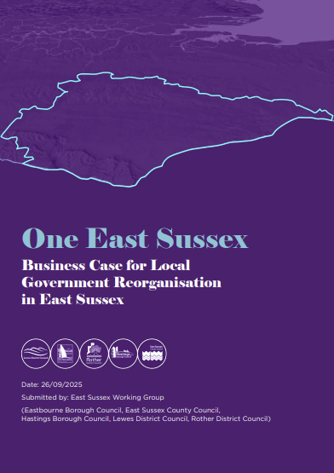
Is underpinned by a robust evidence base, including sign-off of the financial data by S151s.
Takes account of resident and stakeholder feedback.
Aligns with existing service delivery and partnership footprints (e.g. housing, social care, education, public health).
Minimises disruption to statutory services and partnerships.
Builds on established collaboration across the six councils.
Meets the government’s population guidance and maintains a coherent geographic identity.
Creates operational savings and avoids the substantial costs of disaggregation.
Worked up by the six councils, involving cross-party collaboration to reach agreement on the strongest proposal for the area.
Meets all six Government criteria for LGR.
One East Sussex

Slide 16
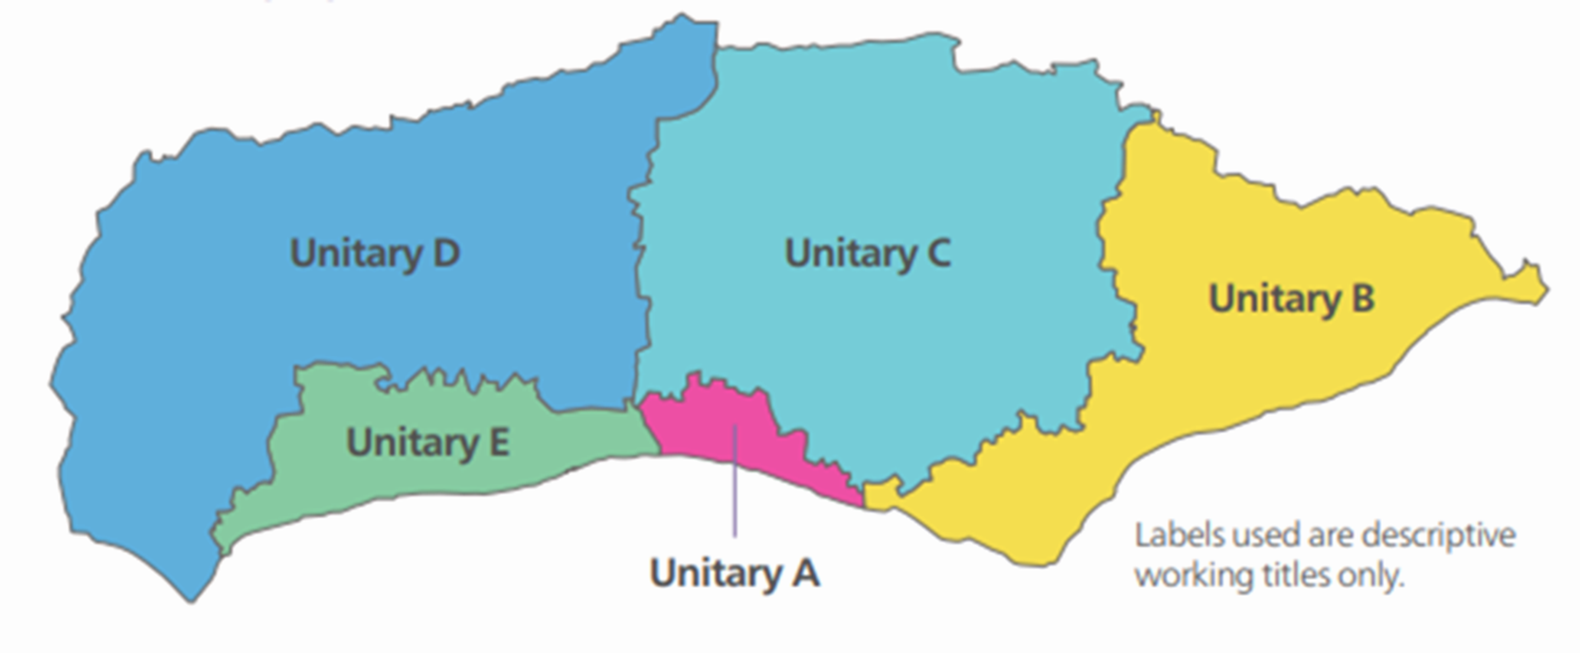
Brighton & Hove City Council’s proposal - East Sussex
Concerns:
  Challenges in maintaining effective community services
  Uncertainties in cost savings and assumptions about funding allocations
  High level of splitting and merging existing councils
  Financial disparities and variation in need across five unitaries
  Population size for viability not met
  Inadequate planning for transition costs
  Insufficient engagement, consultation and strong local opposition

Slide 17
Entirely new vs preparing councils
Entirely new unitary councils B&HCC
Preparing council (One East Sussex):
This is possible everywhere but should be used when a new council(s) are significantly different in scale to all the predecessors, so as to enable democratic representation and service delivery new councils are established. Joint Committees will precede elections to new unitary councils.
This is an alternative model that is possible where the area of a new council matches that of a predecessor council (i.e. single county unitary). An Implementation Executive will precede elections.

Slide 18
New Organisation
New Operating model
New values
New Culture
Huge opportunity for transformation

Slide 19
Structural Changes Order (SCO)
Councils consulted on SCO now (Feb)
Detailed technical document – legal basis for abolishing and establishing councils
Covers:
  Democracy and governance
  Joint committees/Implementation Executive
  Shadow arrangements
  Implementation team

Slide 20
Impact on staff
  No reduction in services councils expected to deliver at either tier
  Skilled and dedicated workforce needed through transition and beyond
  Preparing Council/ Continuing Authority approach and TUPE (Transfer of Undertakings (Protection of Employment)) and other employment protections remain in place
  We will learn from others’ experiences, which suggest it will take a further 2-3 years after ‘go live’ for the new organisation to bring new teams together and harmonise terms and conditions
  We will work closely with staff of all councils as we create the new structures

Slide 21
What you can expect from senior management
  Clear leadership, from officer and political leaders
  Positivity and purpose
  Programme management of the process, including learning from other areas
  Open communication – sharing what we can when we can and listening to and involving staff
  Seeking to put you in the best possible position for the future

Slide 22
Next steps for LGR
  Now until March 2026 – Discovery Phase (getting our house in order)
  Mid-March 2026 – Government expected to decide on unitary government for East Sussex
  Summer 2026 – SCO laid in parliament
  Autumn 2026 – SCO comes into force
  May 2027 – expected election of councillors to ESCC as preparing council for unitary council
  April 2028 – start of new unitary authority (vesting day)

Slide 23
Feedback, questions & answers

